Slide 1

Diabetes Prediction Using Machine Learning Phase-1 Final Review
Department of Computer Science and Engineering
Amrita Vishwa Vidyapeetham
Coimbatore

Slide 2
Diabetes Prediction Using Machine Learning
Team Members FINAL REVIEW
S.No | Reg .No | Name of the Student | Section
1 | CB.EN.U4CSE19612 | D .Bhargav Sreenivas | CSE-F
2 | CB.EN.U4CSE19416 | C.V. Rahul Bharadwaj | CSE-E
3 | CB.EN.U4CSE19125 | K. D. Saran | CSE-B
4 | CB.EN.U4CSE19326 | J.Venkat Ritvik | CSE-D
Project Guide:
Dr Vijay Kumar
Amrita school of computing,
Department of computer science and engineering,
Amrita Vishwa Vidyapeetham,
Coimbatore.

Slide 3
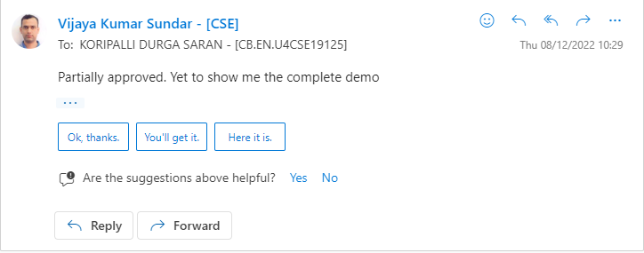
Screen shot of Mail approval from guide

Slide 4
Problem definition
The objective is to predict whether the person has Diabetes or not based on various features using machine learning and IOT

Slide 5
Literature survey (Existing system)
S.no | Authors names | Full Title of the paper with year | Inference from the paper(based on methodology, technology)
1 | Gopalakrishnan B; Dhivya K; Naveena S | Diabetic Patient Prediction using Machine Learning Algorithm[2021] | Work reveals a variety of findings on the analysis of healthcare data using various approaches and procedures. Using various data mining, data management, or a mix of these techniques, numerous analysis and prediction models were researched and designed by several researchers. The researcher keenly verified and build the models that was considered as the best and that also should be suitable for the varies/different medical datasets. Cross validation evaluation method is not using and did not evaluate in the classification algorithm.

Slide 6
Literature survey (Existing system)
S.no | Authors names | Full Title of the paper with year | Inference from the paper(based on methodology, technology)
2 | Priyanka Sonar; K. Jaya Malini | Diabetes Prediction Using Different Machine Learning Approaches[2019] | Diabetes disease produced by rise of sugar level in the plasma. Various computerized information systems were outlined utilizing classifiers for anticipating and diagnosing diabetes using decision tree, SVM, Naive Bayes and ANN algorithms In this paper they discussed the study of Machine Learning Algorithms such as Support Vector Machine, Naïve Bayes, Decision Tree.

Slide 7
Literature survey (Existing system)
S.no | Authors names | Full Title of the paper with year | Inference from the paper(based on methodology, technology)
3 | Md. Faisal Faruque; Asaduzzaman; Iqbal H. Sarker | Performance Analysis of Machine Learning Techniques to Predict Diabetes Mellitus [2019] | In this paper analyzed the early prediction of diabetes by taking into account various risk factors related to this disease using machine learning techniques. Extracting knowledge from real health care dataset can be useful to predict diabetic patients our popular machine learning algorithms, namely Support Vector Machine (SVM), Naive Bayes (NB), K-Nearest Neighbor (KNN) and decision tree

Slide 8
Literature survey (Existing system)
S.no | Authors names | Full Title of the paper with year | Inference from the paper(based on methodology, technology)
4 | Jingyu Xue, China | Research on Diabetes Prediction Method Based on Machine Learning(2020) | In the era of big data, and large amounts of data hide various useful information and knowledge. In the prediction of diabetes, a large amount of data filtered through relevant data sources integrates into a data set for data mining. In this research paper they implemented SVM and Navis bayes.

Slide 9
Justification for the proposed problem
Motivation and Need
The motivation was to experiment with end to end machine learning project and get some idea about deployment platform like Google-COLAB. Using machine learning we have built a predictive model that can predict whether the patient is diabetes positive or not.". This is also sort of fun to work on a project like this which could be beneficial for the society.

Slide 10
Software/Tools Requirements
Google COLAB( Python) – Machine Learning
Arduino(ESP8266) – Glucometer
Flask ( Python library ) - Front End

Slide 11
Data Set (If applicable)
Source of data set:
https://www.kaggle.com/datasets/uciml/pima-indians-diabetes-database?select=diabetes.csv
Justification :
The dataset consists of several medical predictor (independent) variables and one target (dependent) variable, Outcome. Independent variables include the number of pregnancies the patient has had, their BMI, insulin level, age, Blood Pressure, Pregnancies, Skin thickness and so on..

Slide 12
Various features:
Pregnancies
Glucose
Blood Pressure
Skin Thickness
Insulin
BMI
Diabetes pedigree function
Age
Outcome

Slide 13
Work Plan
To create an efficient Machine Learning Model
To create User-interface for the web-app
To Analyze the existing system
To deploy the application online
Integrate ML Model with the interface

Slide 14
Modules and its explanation 1. Dataset Extraction 2. Data Preprocessing and Data Visualization 3. Model Building 4. Models Used – Random Forest, Decision Tree, XgBoost Classifier, Support Vector Machine. 5.IoT

Slide 15
Techniques and algorithms used: - Exploratory Data Analysis (EDA) - Data Visualization - Model Building - Random Forest -Decision Tree - XgBoost Classifier - Support Vector Machine -IoT

Slide 16
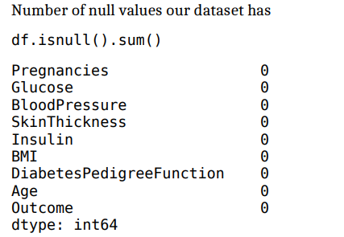
SCREENSHOTS
Data pre-processing:

Slide 17
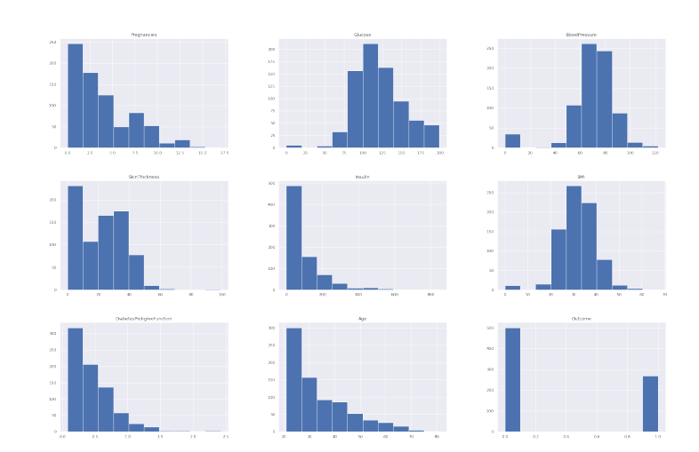
SCREENSHOTS - EDA:
Histogram-

Slide 18
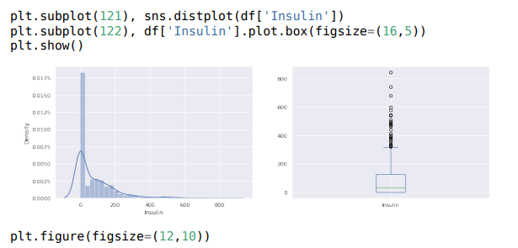
SCREENSHOTS

Slide 19
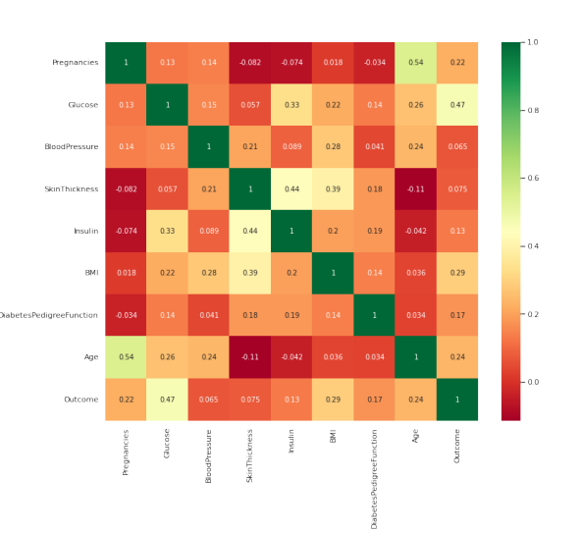
SCREENSHOTS
heatmap:

Slide 20
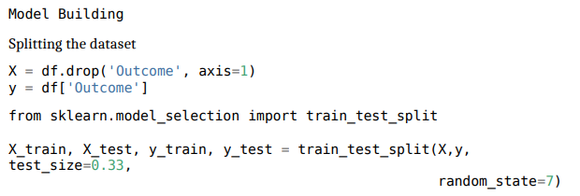
SCREENSHOTS
Model Building-

Slide 21
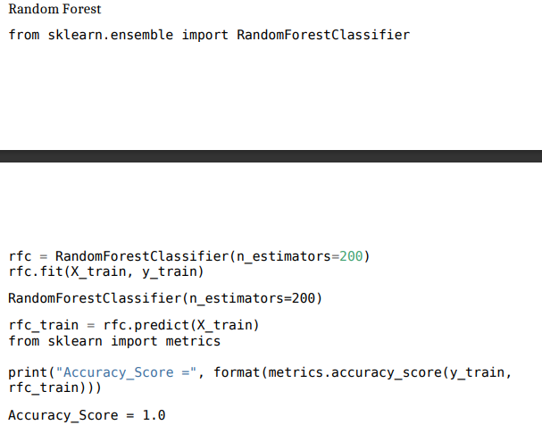
SCREENSHOTS

Slide 22
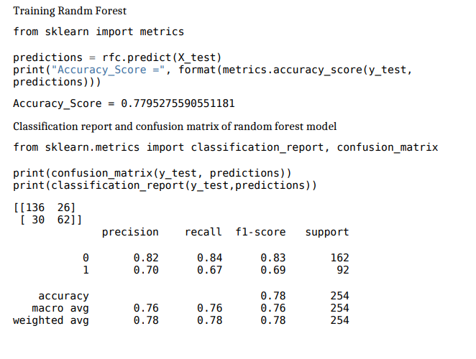
SCREENSHOTS

Slide 23
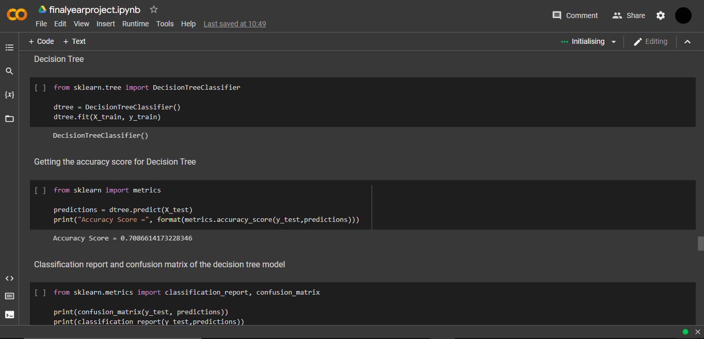
SCREENSHOTS

Slide 24
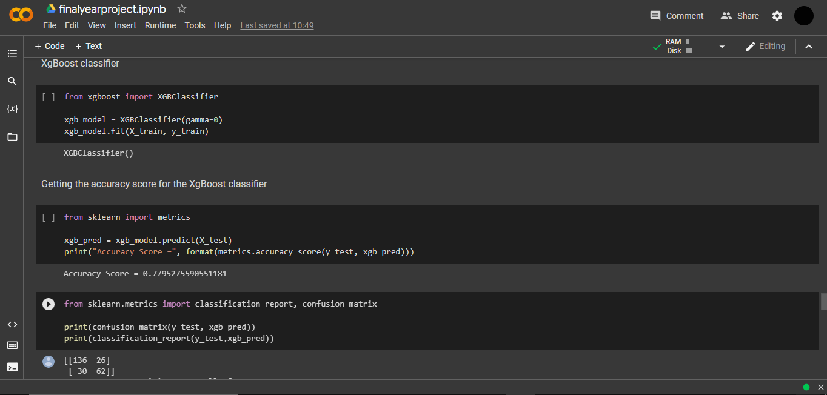
SCREENSHOTS

Slide 25
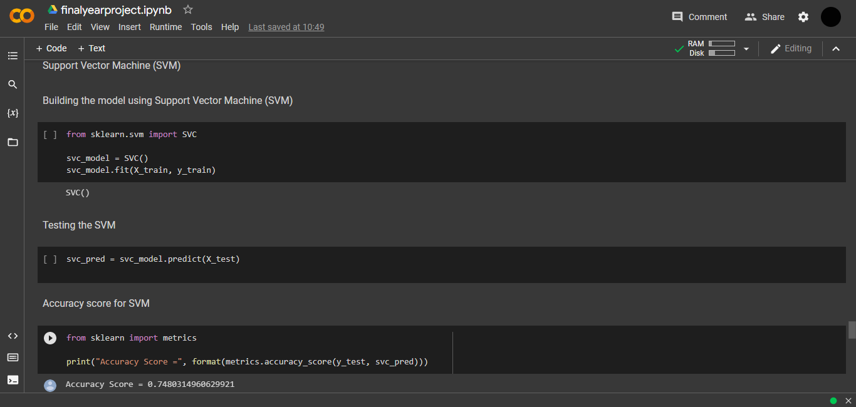
SCREENSHOTS

Slide 26
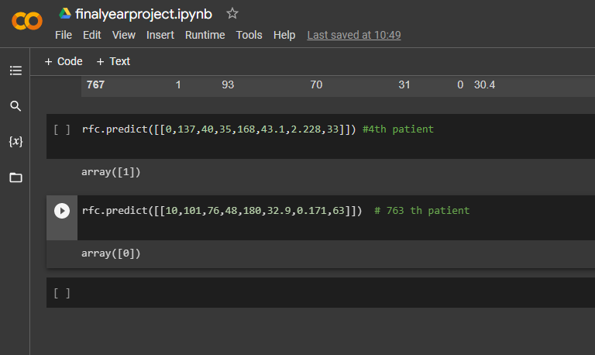
SCREENSHOTS

Slide 27
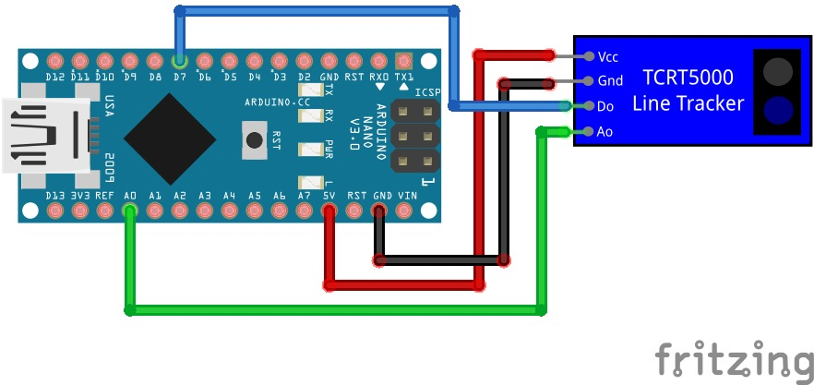
SCREENSHOTS

Slide 28
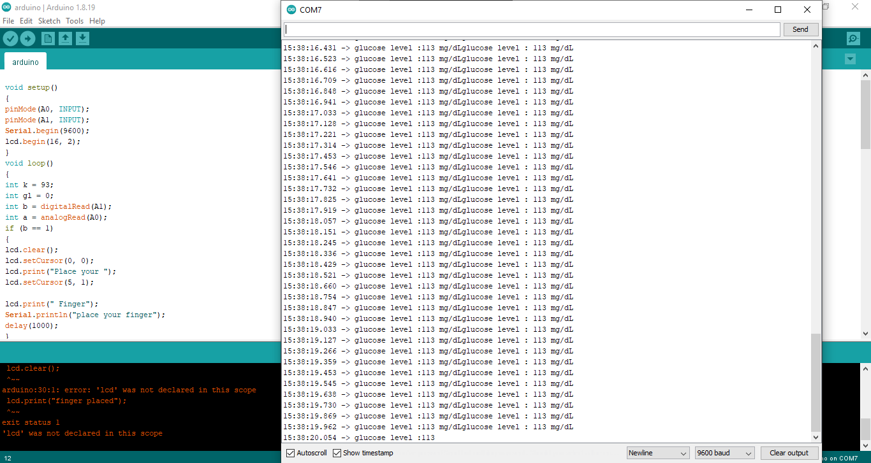
SCREENSHOTS

Slide 29
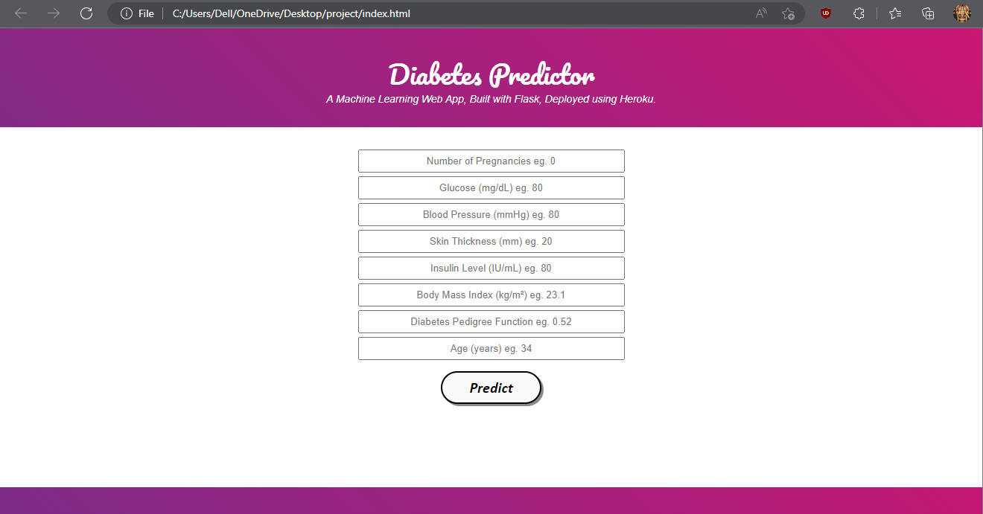
SCREENSHOTS

Slide 30
Results and Discussions 1. Machine Learning Model is predicting whether a person is having Diabetes or not with an accuracy of 76.77% (Random Forest).User can get the output by entering the values in web app. It is integrated with ML model. 2. We used Sensor for Glucometer, where the user will get to use it and can be able to read the Glucose level. The user can enter this Glucose level in the web app. 3. TCRT5000 is used for getting Glucose level and for communication- Arduino UNO board and We used ESP8266 to connect to Internet.

Slide 31
Analysis and findings We built 4 different models which are best suitable for this project and after analyzing we got the best result for the Random Forest model with an accuracy of 76.77%. We came to notice that there are small percentage of precision issues with the Glucometer Sensor.

Slide 32
Plan for Phase 2
Implementation of new machine learning models which are suitable and for best accuracy if possible.
Collect data
Prepare the data
Selection of models
Train the model
Test and evaluate
Deploy the models
We analyze Diabetes using Non Invasive Glucometer

Slide 33
CONCLUSION
After using all these patient records dataset, we are able to build a machine learning model (random forest, decision tree etc) to accurately predict whether or not the patients in the dataset have diabetes or not along with that we were able to draw some insights from the data via data analysis and visualization.
We are successfully able to read the Glucose values from Glucometer.
We are successfully integrated our Web App with the Machine Learning Model.

Slide 34
References
IEEE REFERENCES:
https://ieeexplore.ieee.org/document/9588925/figures#figures
https://ieeexplore.ieee.org/document/8819841/citations#citations
https://ieeexplore.ieee.org/document/8679365
https://ieeexplore.ieee.org/document/8679365
https://ieeexplore.ieee.org/document/8819841

Slide 35
THANK YOU

